Slide 1



FORMAL MODEL - EMBEDDED SOFTWARE - HARDWARE RTL - REQUIREMENTS
Cross Traffic
Management
A four-leg, single-lane crossroad coordinated entirely through V2I / V2V
communication - no traffic lights, no collisions.
PREPARED BY
Boiddo Sumon
Ferdous Soaib
Nnachi-Egwu Nnaemeka
Oyemade Oluwasholape Daniel
UPPAAL
FreeRTOS / C
VHDL / RTL
Timed-automata formal model
IMTask + LaneTask x4 implementation
aim_intersection_manager + testbench

Slide 2





Project Overview
What the system is, and who it serves
STAKEHOLDERS
The system models an cross traffic management system for a four-leg, single-lane crossroad.
Autonomous vehicles cross a shared intersection
without traffic lights, without collisions, and with minimal waiting time.
V2I (vehicle-to-infrastructure) and V2V (vehicle-to-vehicle) communication fully replace traditional signal control.
Autonomous Vehicles
Cross safely and quickly
Intersection Manager
Coordinate crossing, prevent conflicts
Road Infrastructure
Provide the V2I communication point
Other Vehicles
Receive V2V awareness of active crossings
2

Slide 3
Topology, Actors & Use Cases
Four approaches, three actors, ten coordinated use cases
N
Autonomous Vehicle (AV)
Arrive - request - receive grant/defer - broadcast intent - cross - notify exit
Intersection Manager (IM/RSU)
W
E
Check compatibility - grant or defer - update crossing state
Other Vehicles (V2V peers)
Receive crossing-intent broadcasts from active vehicles
S
4-leg intersection - single lane per approach
(German right-hand traffic)
Full use case diagram (UC1-UC10) provided in the Requirements Specification.
3

Slide 4

Functional Requirements
What the system shall do (FR1-FR10)
FR1
Intersection topology - 4 approaches (N/S/E/W), one entry + one exit lane each
FR6
Defer - IM defers on conflict; vehicle waits, then retries
FR2
Movement types - Straight, right turn, or left turn per vehicle
FR7
V2V broadcast - Vehicle broadcasts crossing intent after grant
FR3
V2I request - Vehicle sends direction + movement to the IM
FR8
Crossing - Vehicle crosses within the defined service time
FR4
Compatibility check - IM checks request against active crossings
FR9
Exit notification - Vehicle notifies IM on completion to free state
FR5
Grant - IM grants when compatible; vehicle must wait for it
FR10
No traffic lights - All coordination via V2I reservation + V2V awareness
4

Slide 5







Non-Functional Requirements & the M/M/2 Rule
How well the system must perform, and the compatibility rule behind it
Safety
Liveness
Deadlock-free
Bounded
Throughput
Real-time
Protocol format
No conflicting crossings, ever
Every request eventually granted
IM can always respond
Max 4 vehicles crossing at once
M/M/2: 2 compatible streams at once
Grant/defer decided in one step
Direction + movement + message type
COMPATIBILITY RULE (M/M/2)
Scenario | OK? | Reason
N-straight + S-straight | Yes | Opposite lanes, never cross
E-straight + W-straight | Yes | Opposite lanes, never cross
Any right turns together | Yes | Each stays in its own corner
N-straight + E-straight | No | Paths cross in the center
Any left turn + anything | No | Left turns sweep through center
5

Slide 6
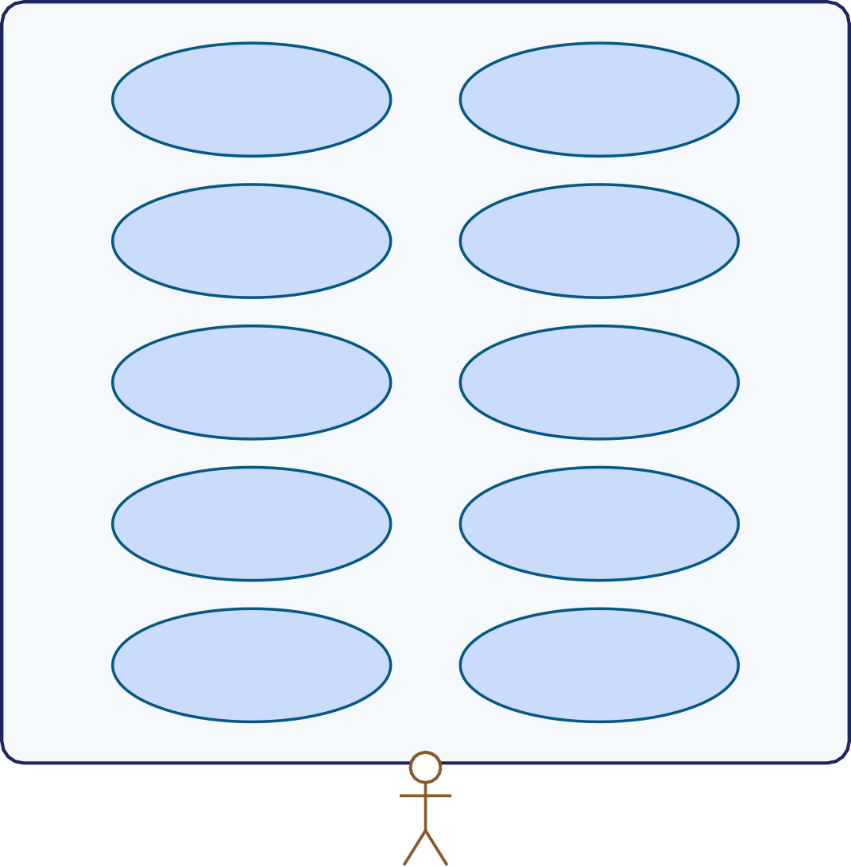


Cross Traffic Management - Use Case Diagram
Three actors, ten coordinated use cases - Autonomous Vehicle, Intersection Manager (RSU), and V2V peer vehicles
Cross Traffic Management System
UC1
Arrive at intersection
UC2
Send crossing request
UC3
Receive grant
UC4
Receive defer & retry
Autonomous
Vehicle (AV)
UC5
Broadcast crossing intent (V2V)
UC6
Receive V2V intent from other car
UC7
Cross intersection
UC8
Send exit notification
Intersection
Manager (IM/RSU)
UC9
Check path compatibility
UC10
Update crossing state
Other Vehicles
(V2V peers)
6

Slide 7

UPPAAL Formal Model
Three timed-automata templates coordinated through typed channels
IM
Car(id)
V2VListener(sid)
1 instance
4 instances - N,S,E,W
4 instances - N,S,E,W
Ready + 4 committed Proc states; grants/defers each of 4 requesters
Idle -> Queued -> WaitResp -> Deferred / V2V -> Crossing -> Idle
Single Listen state; reacts to broadcast channel vv[sid]?
SHARED DECLARATIONS
VERIFICATION QUERIES
int cc - crossCount (vehicles currently crossing)
int cm - crossMode (which movement class owns the intersection)
int rm[4] - requested movement per direction
chan rq[4], gr[4], df[4] - per-direction request / grant / defer
broadcast chan vv[4] - V2V crossing-intent broadcast
Q1-Q5 formally check deadlock-freedom, path exclusivity, and the M/M/2 pairing rule - see next section.
7

Slide 8
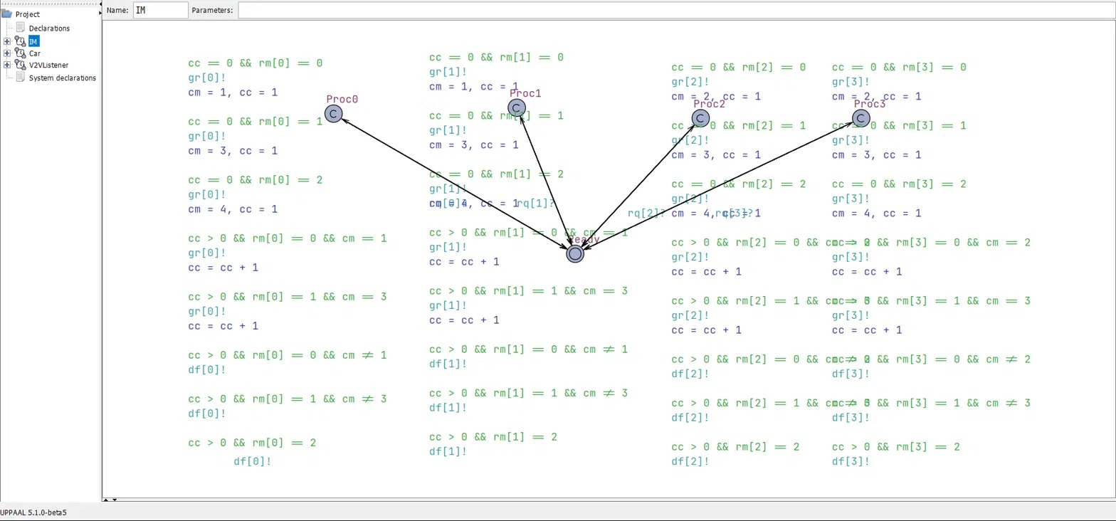
UPPAAL Editor — Intersection Manager (IM) Model
The real IM template: committed Proc0–Proc3 states implement the compatibility guard for each direction
IM TEMPLATE — EDITOR VIEW
Each Proc_i fires gr[i]! when compatible with the active crossing mode, or df[i]! otherwise — mirrors canGrant() in FreeRTOS and can_grant_fn() in VHDL.
Captured from UPPAAL 5.1.0-beta5 (aim_uppaal_final.xml)
8

Slide 9
Car Protocol State Machine
Exact state flow modeled in UPPAAL and mirrored in the LaneTask retry loop
Idle
Queued
WaitResp
V2V
Crossing
choose movement
rq[id]!
gr[id]? / df[id]?
vv[id]! broadcast
d <= SERVICE
defer
Deferred
retry (wait elapsed)
d <= DEFER_T
cc==1: reset cross state to empty | cc>1: decrement
1:1 mapping to code: Idle/Queued/WaitResp/Deferred/V2V/Crossing correspond directly to the retry loop, xQueueSend/xQueueReceive calls, and vTaskDelay(SERVICE_MS) / vTaskDelay(DEFER_MS) in LaneTask() (aim_freertos.c).
9

Slide 10

Formal Verification Results
Five UPPAAL queries check the safety-critical properties of the model
Q1
No deadlock
A[] not deadlock
The system can always make progress
Q2
Path exclusivity
N-straight & E-straight never together
Conflicting paths never overlap
Q3
M/M/2 server 1
N & S cross together only if both straight
Opposite-lane pairing enforced
Q4
M/M/2 server 2
E & W cross together only if both straight
Opposite-lane pairing enforced
Q5
Bounded crossings
cc <= 4 at all times
Never more than 4 vehicles crossing
All five properties are verified TRUE against the UPPAAL model, giving formal assurance that the same rules implemented in FreeRTOS and VHDL are safe by construction.
10

Slide 11
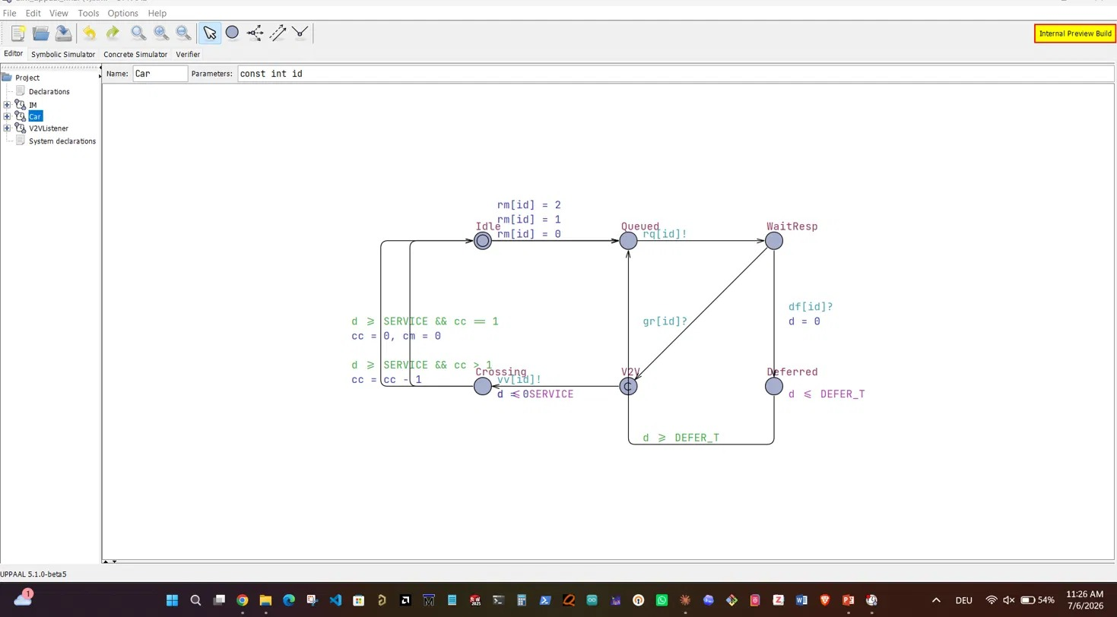
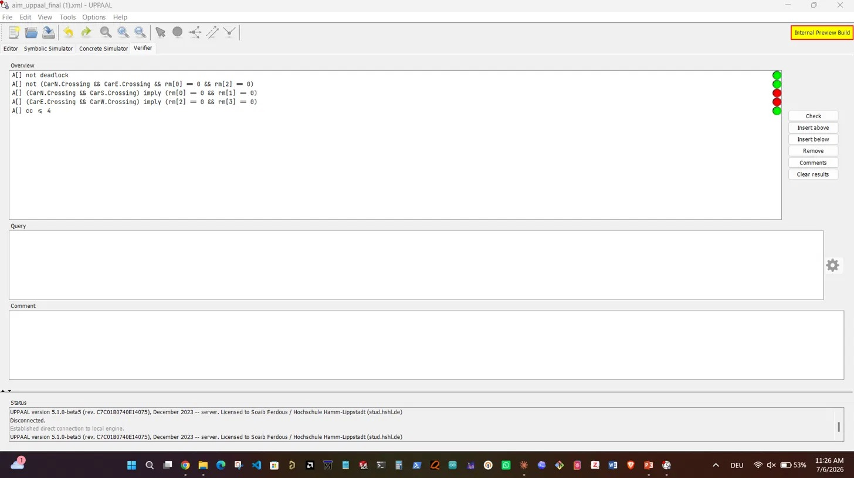
UPPAAL Editor — Car Template & Verifier
Left: the full Car(id) state machine as modeled. Right: all five safety and liveness queries in the Verifier
CAR TEMPLATE — EDITOR VIEW
VERIFIER — SAFETY & LIVENESS QUERIES
Idle → Queued → WaitResp → Deferred/V2V → Crossing → Idle, with d ≤ DEFER_T and d ≤ SERVICE bounding each wait.
A[] not deadlock, path exclusivity, M/M/2 server pairing (Q3/Q4), and cc ≤ 4 — all checked against the model.
Captured from UPPAAL 5.1.0-beta5 (aim_uppaal_final.xml)
11

Slide 12
FreeRTOS System Architecture
Direct task-for-template mapping from the UPPAAL model
IMTask
LaneTask
V2VListenerTask
x1 - priority +3 (highest)
x4 - priority +1
x4 - priority +2
Reads v2i_reqQueue; runs canGrant(); sends GRANT/DEFER; handles EXIT
Arrival timing; V2I request/retry loop; V2V broadcast; crossing delay
Subscribes to v2v_broadcastQueue[dir]; updates awareness table
QUEUES & SYNCHRONIZATION
DESIGN NOTE
v2i_reqQueue - all 4 lanes to IM (shared request channel)
v2i_respQueue[4] - IM to lane[dir] (GRANT / DEFER)
v2v_broadcastQueue[4] - one per sender, fan-out to listeners
imMutex, v2vMutex - protect crossCount/crossMode and awareness table
IMTask runs at the highest priority so it never blocks a LaneTask waiting on a grant/defer decision - directly satisfying NFR6 (real-time response): the IM always decides within one atomic step.
12

Slide 13
V2I / V2V Protocol Flow in Code
One crossing cycle, from arrival to exit notification
1
2
3
4
5
6
Arrive
Request
Grant / Defer
Broadcast
Cross
Exit
random inter-arrival
[2000-8000 ms]
V2IRequest(dir,move)
via v2i_reqQueue
canGrant() check
responds on v2i_respQueue
V2V intent to all
other directions
hold intersection for
SERVICE_MS = 4000
v2i_exit() decrements
crossCount
On DEFER, the vehicle waits DEFER_MS = 3000 ms then re-enters step 2 (retry) - guaranteeing liveness (NFR2) without polling the IM continuously.
KEY TIMING CONSTANTS (aim_freertos.c)
Constant | Value | Meaning
MIN_ARR_MS / MAX_ARR_MS | 2000 / 8000 | Vehicle inter-arrival window
SERVICE_MS | 4000 | Time spent crossing the intersection
DEFER_MS | 3000 | Wait time before retrying after a defer
MAX_QUEUE | 6 | Max queued vehicles per approach
13

Slide 14
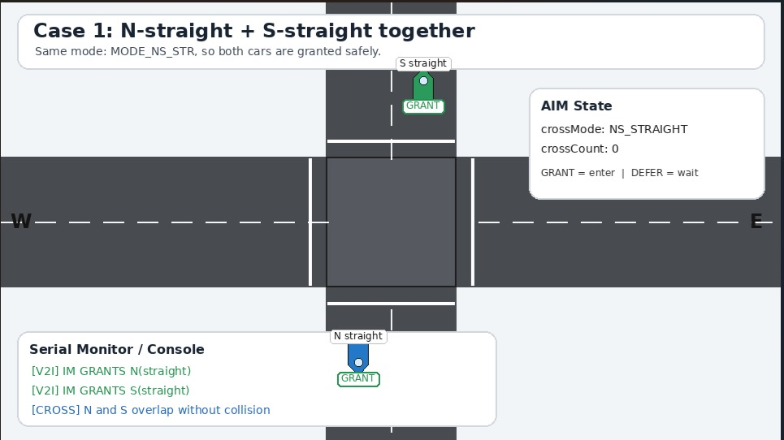
Runtime Simulation — Compatible Crossings (Case 1)
FreeRTOS AIM simulator: canGrant() lets non-conflicting movements cross the intersection together
CASE 1 — N-straight + S-straight
Same mode (MODE_NS_STR) — both cars GRANTed; crossMode: NS_STRAIGHT. This is M/M/2 server 1 (opposite lanes never cross).
Captured from the FreeRTOS AIM simulator console (aim_freertos.c)
14

Slide 15

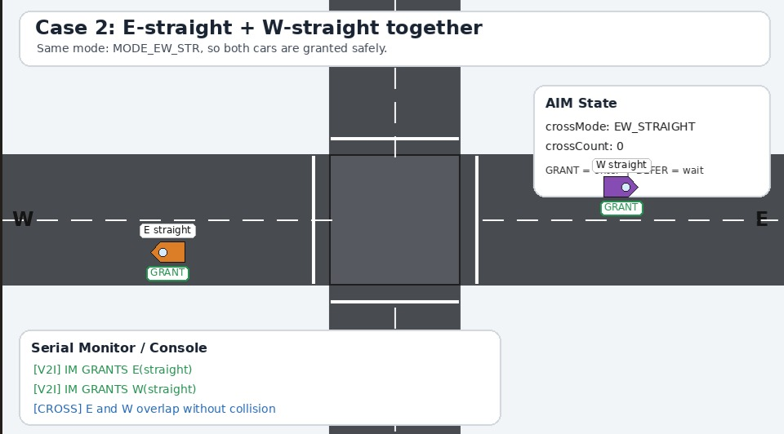
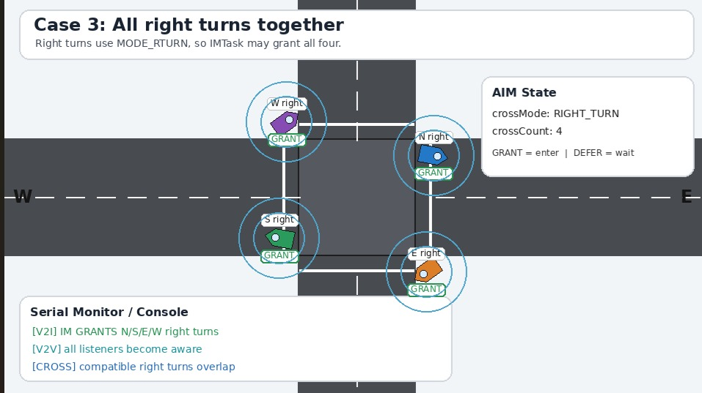
Runtime Simulation - Compatible Crossings
FreeRTOS AIM simulator: canGrant() lets non-conflicting movements cross together
CASE 2 - E-straight + W-straight
CASE 3 - All Right Turns Together
Same mode (MODE_EW_STR) - both cars GRANTed; crossMode: EW_STRAIGHT, crossCount: 0 before entry.
MODE_RTURN allows all four corners at once - crossMode: RIGHT_TURN, crossCount: 4, all four GRANTed.
Captured from the FreeRTOS AIM simulator console (aim_freertos.c) - matches the UPPAAL canGrant() guards exactly.
15

Slide 16

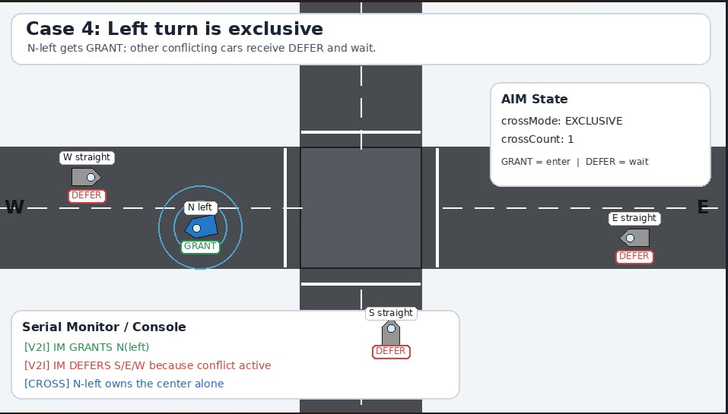
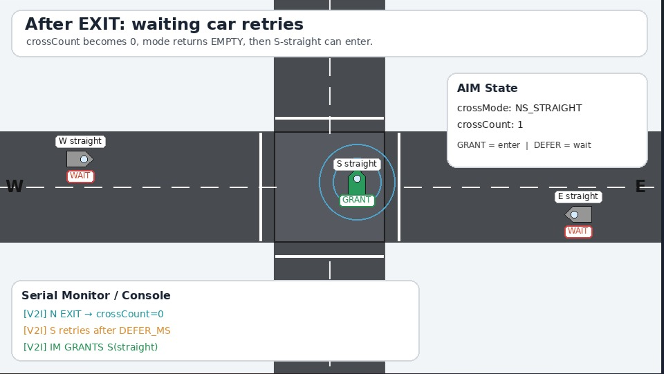
Runtime Simulation - Exclusive Left Turn & Retry
canGrant() defers conflicting cars, then grants the retry once the intersection clears
CASE 4 - Left Turn is Exclusive
AFTER EXIT - Waiting Car Retries
N-left GRANTed alone (MODE_EXCL); S/E/W straight requests all DEFER until it exits.
crossCount returns to 0 on EXIT; the deferred car retries after DEFER_MS and is GRANTed.
Demonstrates NFR2 (liveness): every deferred vehicle is eventually granted - no starvation.
16

Slide 17
VHDL Hardware Implementation
entity aim_intersection_manager - the same rule, synthesized as RTL
KEY PORTS
can_grant_fn(dir, mv, mode_r, excl, cnt)
clk, rst
system clock; synchronous active-high reset
excl='1' -> false (exclusive left-turn active)
cnt = 0 -> true (intersection empty)
mv = LEFT -> false (left turns always exclusive)
get_mode_fn(dir,mv) = mode_r -> true
otherwise -> false (defer)
v2i_req_valid[4], v2i_req_move[8]
1 bit + 2 bits/car - request + movement (00 straight, 01 right, 10 left)
v2i_grant[4], v2i_defer[4]
one-cycle pulse per car - grant or defer
v2i_exit[4]
car finished crossing
v2v_intent[4] -> v2v_aware[4]
V2V broadcast passthrough
cross_count[3], cross_mode[2]
cnt_reg (0-7) and mode_reg ("00".. "11")
TESTBENCH - tb_aim_intersection_manager (ModelSim / Questa, 100 MHz / 10 ns clk)
T1-T2
T3
T4
N then S straight, empty -> both GRANT, M/M/2 server 1 (mode 01)
E straight while NS active -> DEFER (cross-conflict)
N & S exit -> cross_count=0, mode reset to empty
T5
T6
T7-T8
N & W broadcast V2V intent -> v2v_aware reflects both
All 4 right turns at once -> all GRANT, mode=11 (right-turn)
N left turn -> GRANT + exclusive; S straight during it -> DEFER
17

Slide 18

M/M/2 Crossing-Mode Mapping
getMode()/canGrant() in C and can_grant_fn() in VHDL enforce the identical rule
Mode | Meaning | VHDL encoding | Compatible movements
MODE_EMPTY | Intersection idle | "00" | Any new request accepted
MODE_NS_STR (server 1) | N/S straight active | "01" | Only more N/S straight requests
MODE_EW_STR (server 2) | E/W straight active | "10" | Only more E/W straight requests
MODE_RTURN | Right turns active | "11" | All right turns, any direction
MODE_EXCL | Left turn active | excl_flag='1' | No other movement until it exits
canGrant() / can_grant_fn(): true if the intersection is empty, or the requested movement's mode matches the active mode and is shareable (right turns or the same straight server). Left turns and cross-conflicting straights are always deferred - identical logic in C and VHDL.
18

Slide 19

Traceability: Requirement to Implementation
The same behavior, expressed three ways
Requirement | UPPAAL | freeRTOS | VHDL
FR4 - compatibility | Guards on Proc transitions | canGrant() function | can_grant_fn() in RTL
FR5/FR6 - grant/defer | gr[id]! / df[id]! | RESP_GRANT / RESP_DEFER | v2i_grant / v2i_defer pulses
FR7 - V2V broadcast | vv[id]! broadcast chan | v2v_broadcastQueue | v2v_intent input bus
NFR1 - safety | Q2 verified | canGrant() prevents conflict | can_grant_fn() hardware
NFR4 - bounded (<=4) | Q5 verified | cc<=4 max crossings | cnt_reg range 0-7
NFR5 - M/M/2 | cm modes 1 and 2 | MODE_NS_STR / MODE_EW_STR | mode_reg "01" / "10"
All three columns were independently verified: 5 UPPAAL queries, the aim_freertos.c retry/priority design, and 8 directed VHDL testbench cases (tb_aim_intersection_manager).
19

Slide 20

System Constraints & Scope
Boundaries the design operates within (SC1-SC7)
SC1
Single-lane approaches - no dedicated turn lanes
SC2
All vehicles are V2I / V2V capable
SC3
IM is a single roadside unit (RSU)
SC4
Queuing model: M/M/2 (Markovian arrivals, exponential service, 2 servers)
SC5
Hardware implementation: VHDL (aim_intersection_manager), verified in ModelSim / Questa
SC6
Software implementation: C with FreeRTOS
SC7
Formal model: UPPAAL timed automata
20

Slide 21
KEY TAKEAWAYS
One Rule, Three Implementations
Safety by construction
The same canGrant() compatibility rule is enforced identically in UPPAAL, C/FreeRTOS, and VHDL
Formally verified
5 UPPAAL queries confirm no deadlock, path exclusivity, correct M/M/2 pairing, and a bounded crossing count
Liveness guaranteed
The defer-and-retry loop ensures every vehicle is eventually granted - no starvation
No traffic lights needed
V2I reservation plus V2V awareness fully replace signal-phase control
Cross Traffic Management - UPPAAL x FreeRTOS x VHDL

Slide 22
THANK YOU FOR LISTENING
QUESTIONS?

